Slide 1
Project Pitch
Guido I. Guberman – Brainhack school 2018

Slide 2

Background
Undergrad: Cognitive Science (McGill)
EEG
Decision-making research
Monkey intracellular recording
MD/PhD (McGill):
2 years of med school
3-4 years of PhD <- Where I am (2/4)
2 more years of med school
5 years of residency
2-4 years of post-doc

Slide 3
My lab

Slide 4
Why study mTBIs using neuroimaging?
Premature clearance
Asymptomatic damage
OR
Incomplete recovery
Repeat injury
AND
Accumulating damage
Notes:
Detecting brain damage from head injuries (especially when asymptomatic) is necessary to prevent accumulating damage.

Slide 5
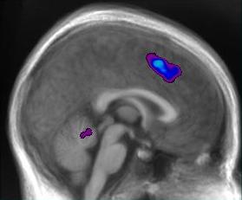
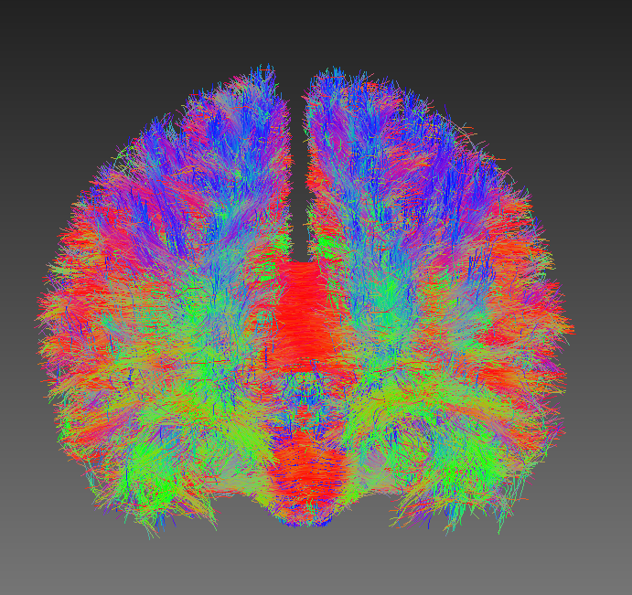
Being rebellious
My lab
Me

Slide 6

My path so far: last year
Self-directed learning

Slide 7
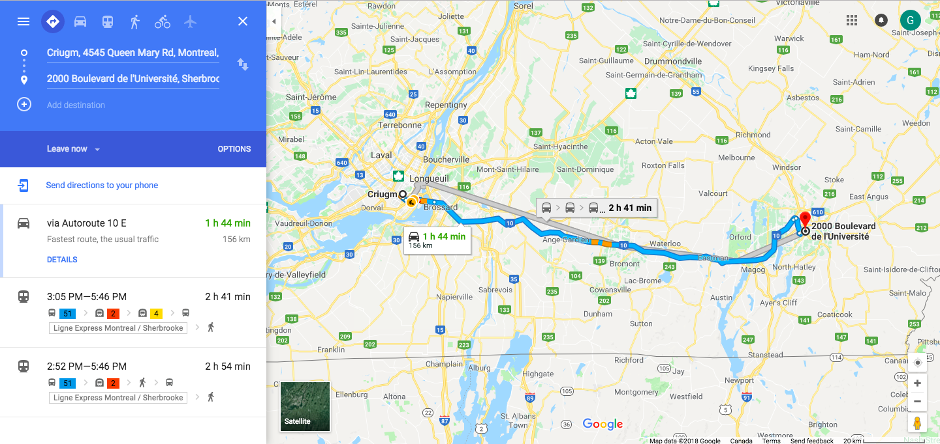
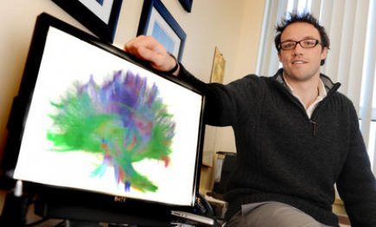
My path so far: this year

Slide 8
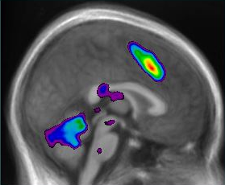
Previous work from my lab
Healthy
Concussed
Keightley et al., 2014
Notes:
It is not known why
One possibility: connections of these working memory networks are damaged

Slide 9
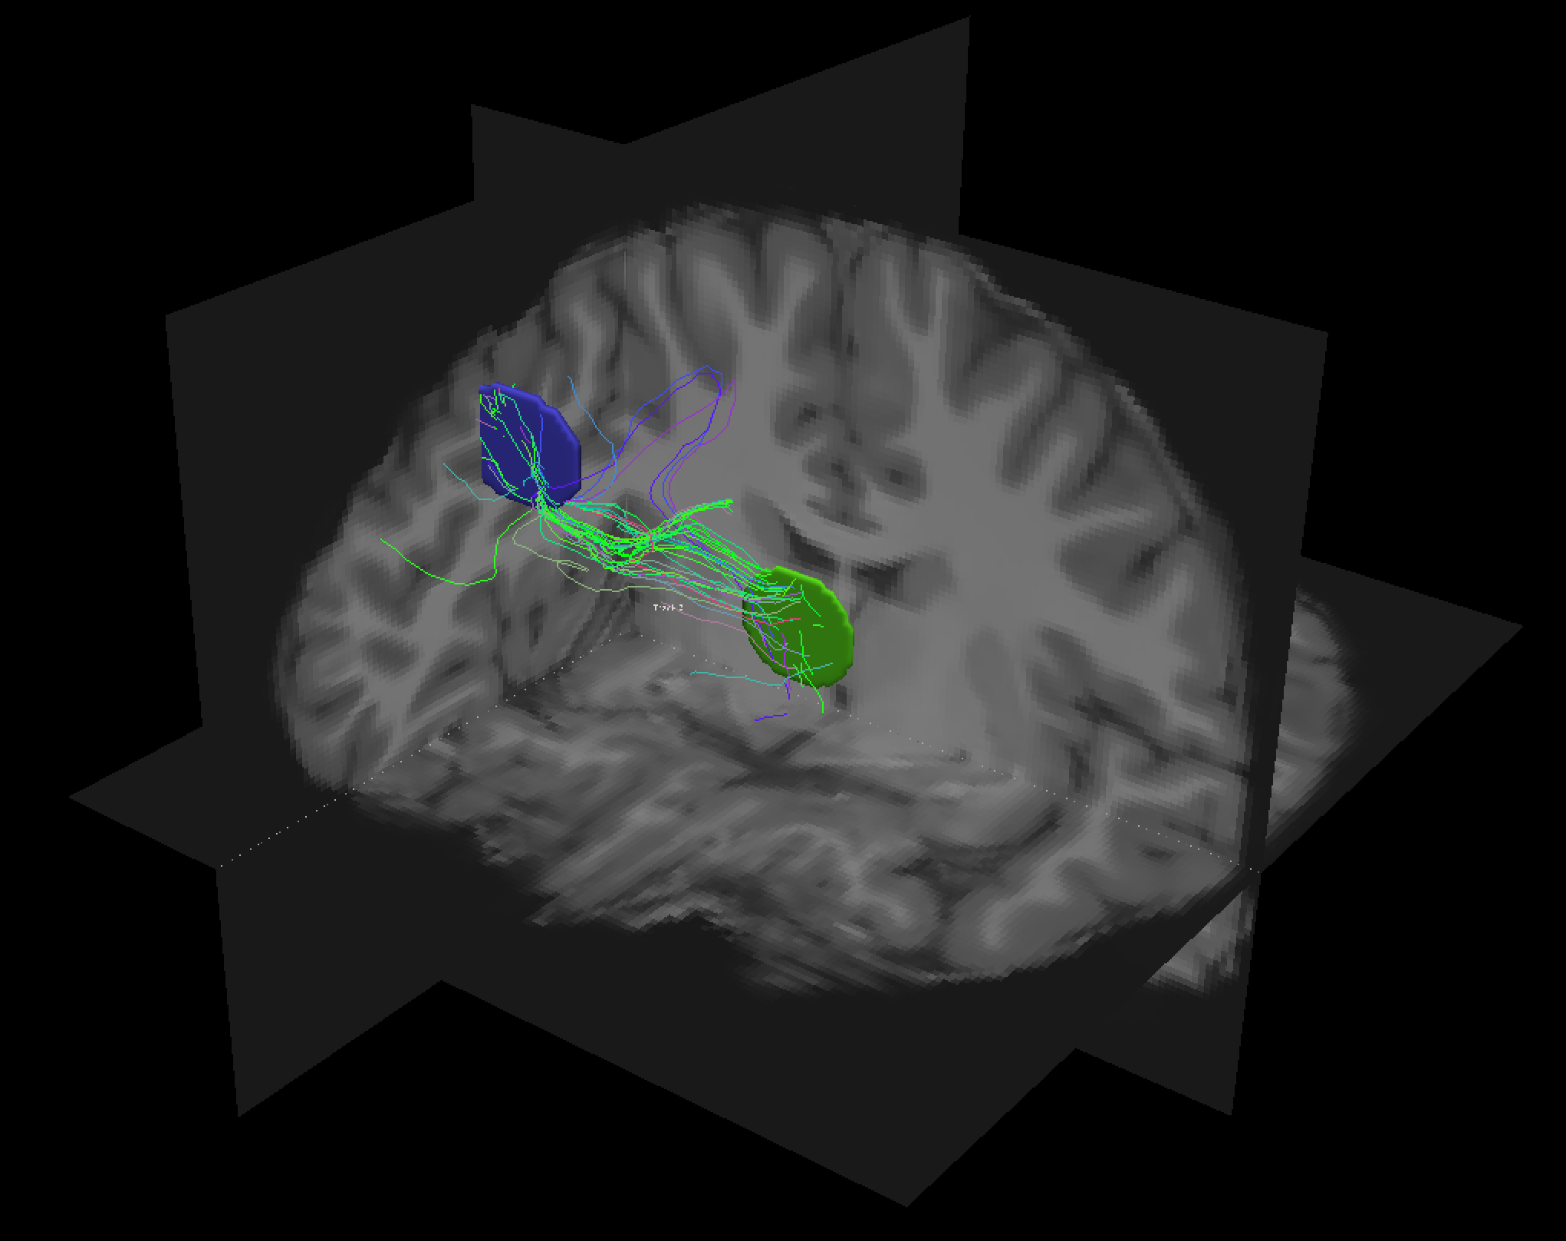
Procedure

Slide 10
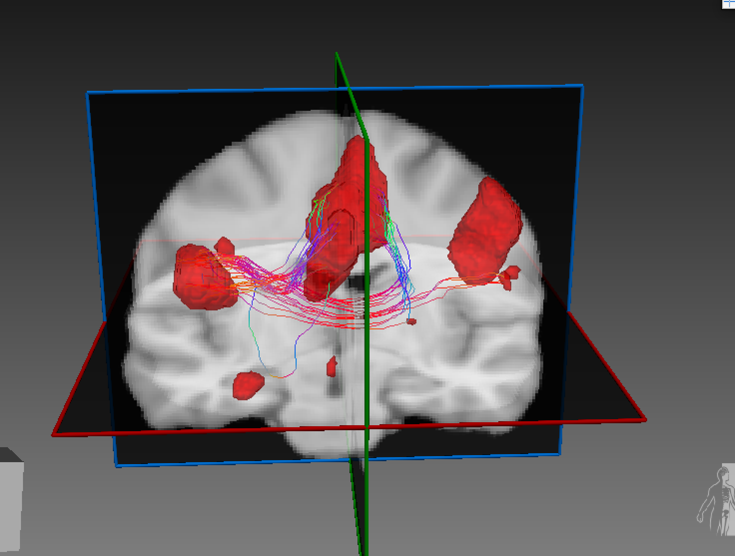
Problem
No single way to do it: (e.g.: thresholding)
High thresholding:
No white-matter voxels = no tracts
Low thresholding:
Excessively large tracts, a lot of false positives
Current approaches are arbitrary

Slide 11
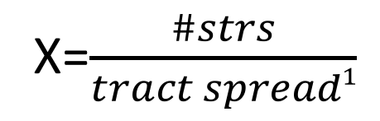
Idea: calculating ROI “reliability”
X=$\frac{\#strs}{tract spread1}$
Run tractography by seeding from a pair of ROIs
Calculate X
Repeat for incrementally larger numbers of seeds-per-voxel
1: Yeatman et al. 2012
Notes:
https://www.ncbi.nlm.nih.gov/pmc/articles/PMC3498174/

Slide 12
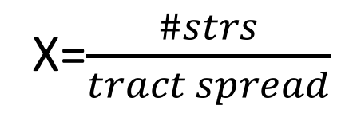
“Unreliable” ROIs
X=$\frac{\#strs}{tract spread}$
#strs ↑
Tract spread ↑
Result: X should remain similar
Notes:
https://www.ncbi.nlm.nih.gov/pmc/articles/PMC3498174/

Slide 13
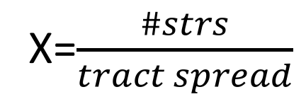
“Reliable” ROIs
X=$\frac{\#strs}{tract spread}$
#strs ↑
Tract spread should remain stable
Result: X should increase
Notes:
1st important output: ROI reliability

Slide 14
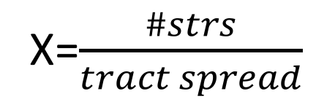
“Reliable” ROIs
ROI2
X=$\frac{\#strs}{tract spread}$
ROI3
ROI1
Reliability of ROI1 = average of X across all values of seeds-per-voxel for every tract connecting ROI1 against all other ROIs tested
Notes:
1st important output: ROI reliability

Slide 15
Optimizing ROIs
If #str/tract spread reflects ROI reliability -> modify ROIs to maximize “reliability”
Notes:
2nd important output: optimized ROIs

Slide 16
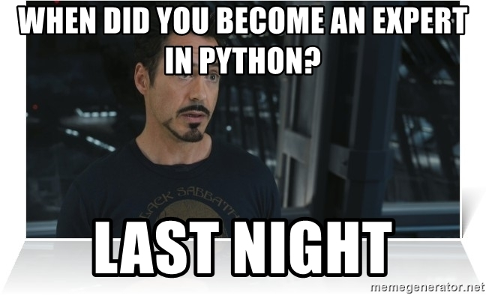
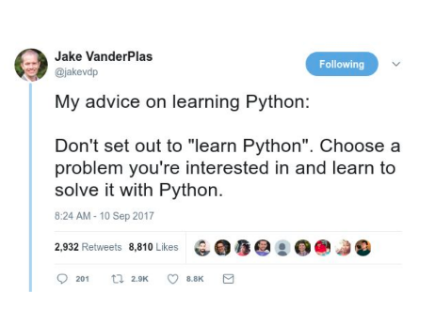
What I need
DURING THE BRAINHACK SCHOOL

Slide 17

What I need
A patient Python tutor
Someone with fMRI knowledge
Advantage if the person has experience with DWI
Further details in my README.md and CONTRIBUTING.md files

Slide 18
What I can offer
DWI:
Processing
Tractography
Analysis
Matlab
Brain trauma
Neuroscience
Anatomy

Slide 19
THANK YOU

